Slide 1
JUnit5 Testing
.

Slide 2
Testing
Testing is use to find the defect or error or bugs in the application.
Testing means we are running the program without main method or function to check function functionality.

Slide 3
Types Of Testing
1.Manual Testing:-
Testing any software or an application according to the client's needs without using any automation tool is known as manual testing.
In other words, we can say that it is a procedure of verification and validation.
2.Automation Testing:-
It uses specific tools to automate manual design test cases without any human interference.
In other words, we can say that whenever we are testing an application by using some tools is known as automation testing.

Slide 4
Unit Testing
It is a testing technique using which individual modules are tested to determine if there are any issues by the developer himself.
It is a type of manual testing.
It is a type of white box testing where individual unit of component of software are tested.
Unit means smallest set of code written in method or functions.

Slide 5
JUnit
JUnit is a unit testing framework for Java programming language.
It plays a crucial role test-driven development.
JUnit is a open source light weighted framework provided by third party which help to do the testing for java code.
Junit provides annotations to identify test methods.
Junit provides assertions for testing expected results.
Junit provides test runners for running tests.
JUnit tests allow you to write codes faster, which increases quality.
JUnit shows test progress in a bar that is green if the test is running smoothly, and it turns red when a test fails.

Slide 6
JUnit5
JUnit 5 is the next generation of JUnit.
The goal is to create an up-to-date foundation for developer-side testing on the JVM.
This includes focusing on Java 8 and above, as well as enabling many different styles of testing.
jUnit 3.x without annotation
jUnit 4.x with annotation
jUnit 5.x with few more new annotation with combination of more than one framework.
Test case : it is a type class which contains more than one test method with annotation @Test which help to test function functionality .
Test suite : To run more than one test case classes at the same time when we can use test suite. Test suite is a combination of more than one test case classes

Slide 7
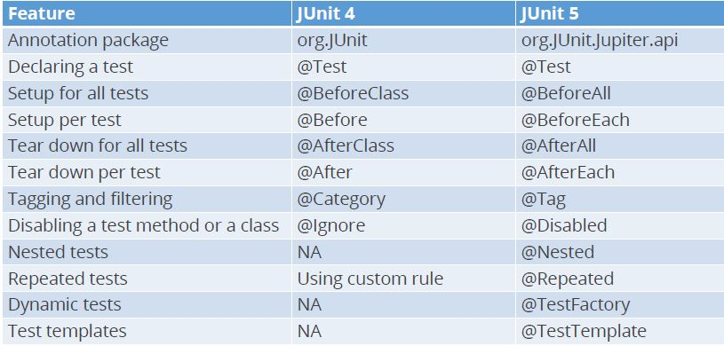
Moving from JUnit 4 to JUnit 5

